Slide 1
Introduction to Deep Learning, part 1
Krzysztof Kolasiński, Rafał Cycoń - 30 March - 2017

Slide 2
Presentation outline
A short motivation for DL
Mathematical model of neuron
DL - extreme crash course
This talk:
more technical, less practical
we want to stress the importance of basic building blocks
dense material, may be hard to follow
non overlapping concepts
assignment: try to understand covered concepts
the feedback form
All slides and notebooks: https://github.com/fornaxco/ai-tech-meetup

Slide 3
Why do we need DL?
A short motivation

Slide 4
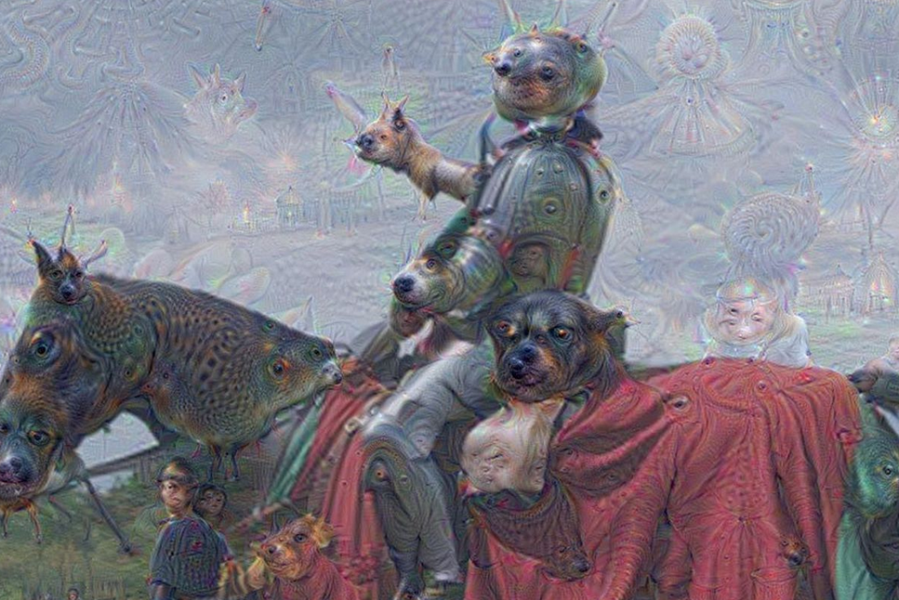
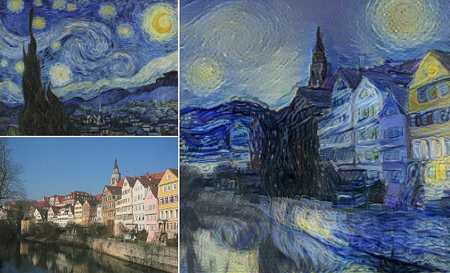
Why do we need DL?
DL is fun!
Deep dream
Neural style transfer

Slide 5
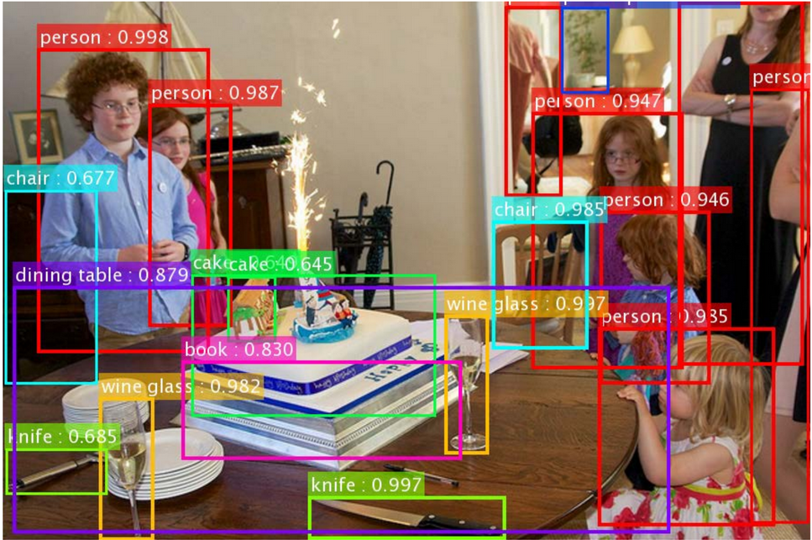
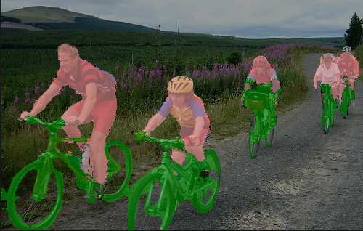
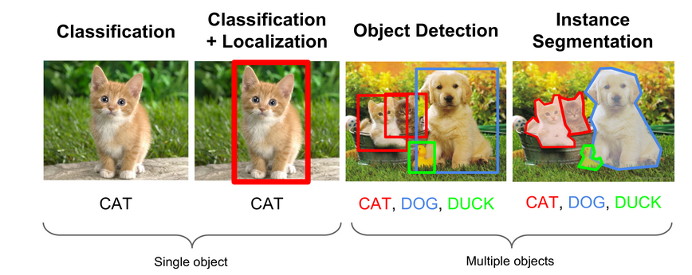
Why do we need DL?
2. DL is important
image segmentation
object detection
Source: CS231n (Stanford)

Slide 6
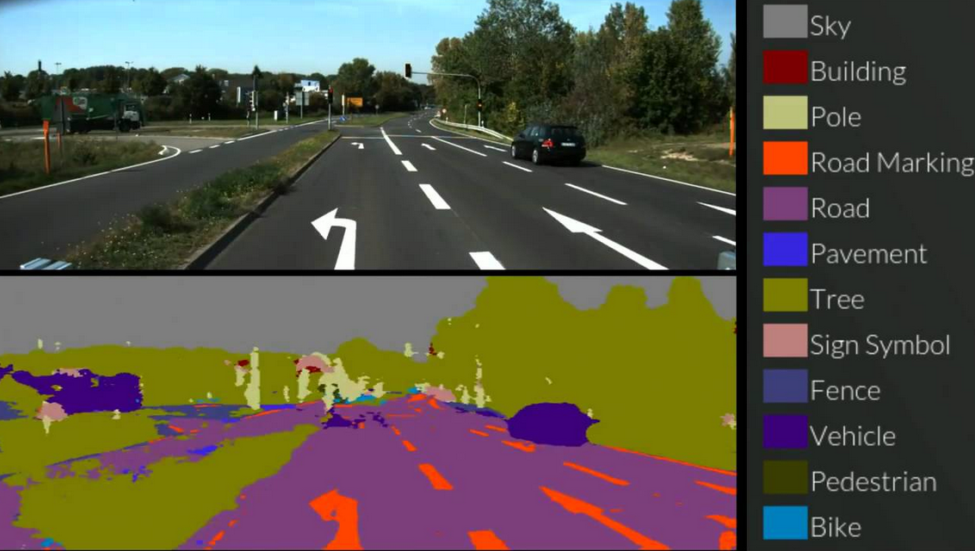
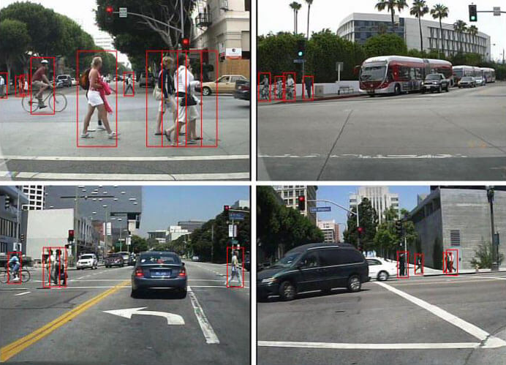
Why do we need DL?
2. DL is important
Application to self driving cars

Slide 7
And many more…

Slide 8
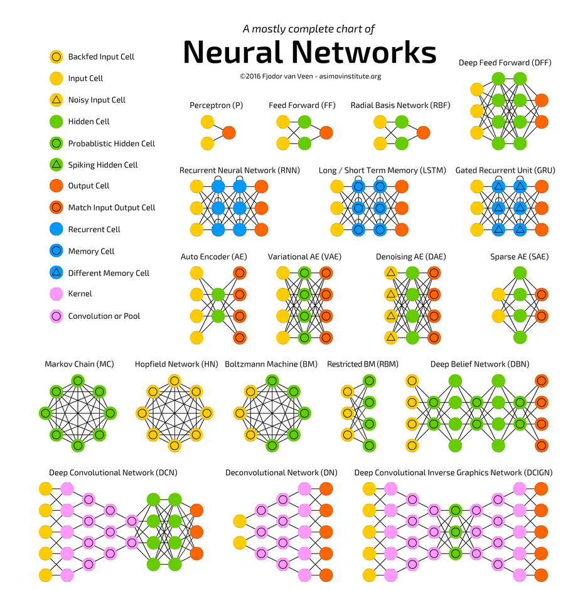
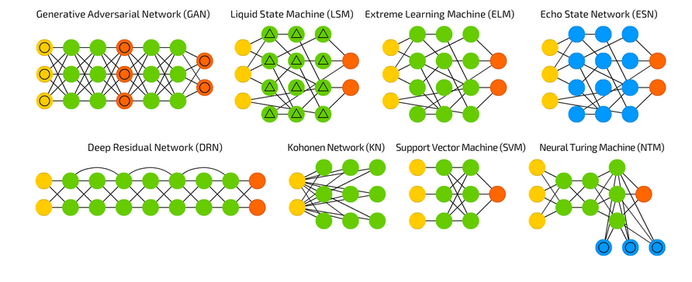
The NN zoo
Understanding basic building blocks helps to create new and understand existing architectures
That NN family is growing up every day
http://www.asimovinstitute.org/neural-network-zoo/
Notes:
widzimy graf, zrozumienie pojedycznych jednostek pozwoli nam na zrozumienie reszty

Slide 9
Prologue: The basics

Slide 10
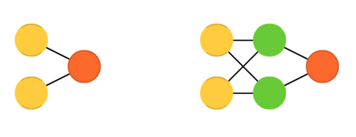
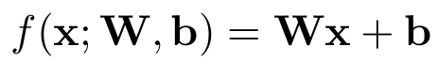
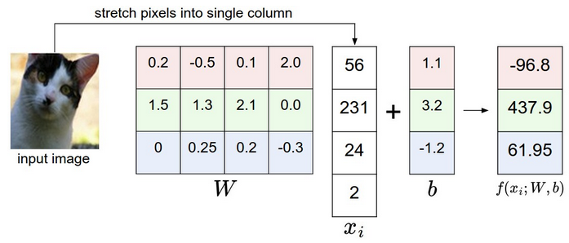
The simple Neuron unit
Feed forward Neural Network
We define linear unit as
source: Stanford CS231 course

Slide 11
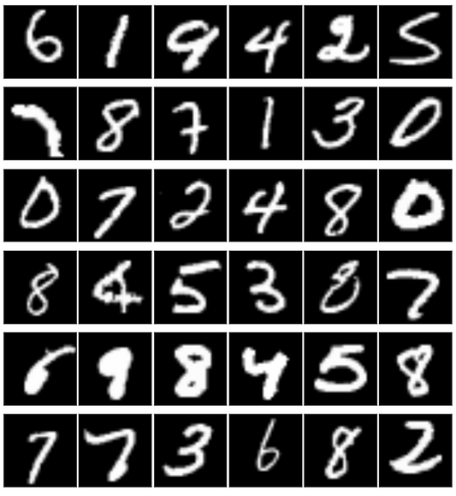
The simple Neuron unit
Linear classifier
Case study: MNIST dataset and linear classifier
Steps:
Dataset consists of N images (28x28 pixels/gray scale) of handwritten digits between 0-9
source: Stanford CS231 course

Slide 12
The simple Neuron unit
Linear classifier
Case study: MNIST dataset and linear classifier
Steps:
Dataset consists of N images (28x28 pixels/gray scale) of handwritten digits between 0-9
The images are labeled (0-9)
source: Stanford CS231 course

Slide 13
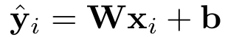
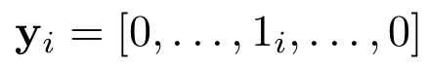
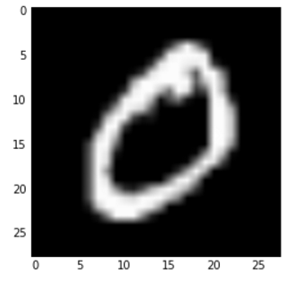
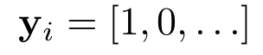
The simple Neuron unit
Linear classifier
Case study: MNIST dataset and linear classifier
Steps:
Dataset consists of N images (28x28 pixels/gray scale) of handwritten digits between 0-9
The images are labeled (0-9)
Lets solve the simplest possible supervised task:
model prediction
We can compare this prediction with given label
source: Stanford CS231 course
For example if the input image is 0 the label becomes

Slide 14
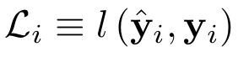
The simple Neuron unit
Linear classifier
Case study: MNIST dataset and linear classifier
Steps:
Dataset consists of N images (28x28 pixels/gray scale) of handwritten digits between 0-9
The images are labeled (0-9)
Lets solve the simplest possible supervised task:
For each training example i we can define the loss function
source: Stanford CS231 course
In general lower loss == better prediction

Slide 15
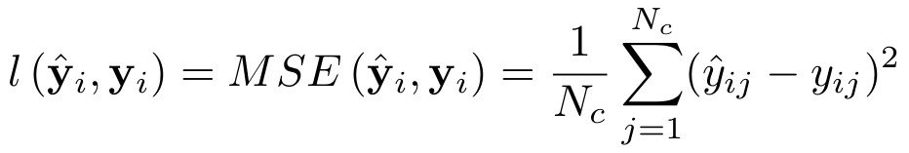
The simple Neuron unit
Linear classifier
Case study: MNIST dataset and linear classifier
Steps:
Dataset consists of N images (28x28 pixels/gray scale) of handwritten digits between 0-9
The images are labeled (0-9)
Lets solve the simplest possible supervised task:
For each training example i we can define the loss function
For simplicity we choose MSE loss
source: Stanford CS231 course

Slide 16
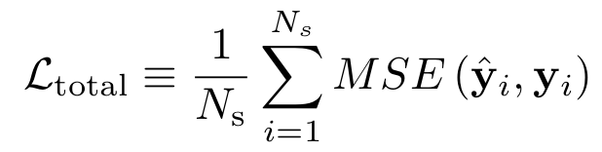
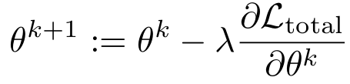
The simple Neuron unit
Linear classifier
prediction loss per one image
The MNIST dataset (keras) consists of 60000 training images. Hence the total loss is given:
Target: find W and b such that loss will be minimal
Solution: use gradient descent method to update model parameters:
one has to compute gradient of loss w.r.t. model parameters
Notes:
regresja liniowa ma rozwiazanie analityczne, ale my sie ograniczymy do GD, gratient mozna policzyc bo funkcja jest różniczkowalna, ale
nie trzeba bo zrobi to za nast np. tensorflow czy theano

Slide 17
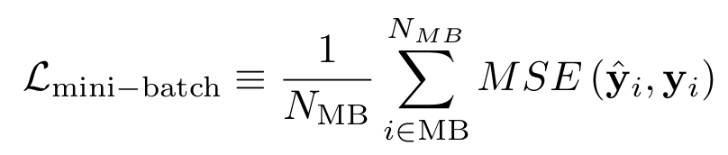
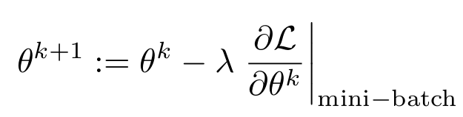
The simple Neuron unit
Linear classifier
prediction loss per one image
The MNIST dataset (keras) consists of 60000 training images. Hence the total loss is given:
It is more practical to use mini-batch approximation of gradients instead taking whole sum:
mini-batch size
This lead to mini-batch stochastic gradient descent algorithm:
Notes:
regresja liniowa ma rozwiazanie analityczne, ale my sie ograniczymy do GD, gratient mozna policzyc bo funkcja jest różniczkowalna, ale
nie trzeba bo zrobi to za nast np. tensorflow czy theano,
mini-batch pozwala na effective computation, which can be parralized

Slide 18
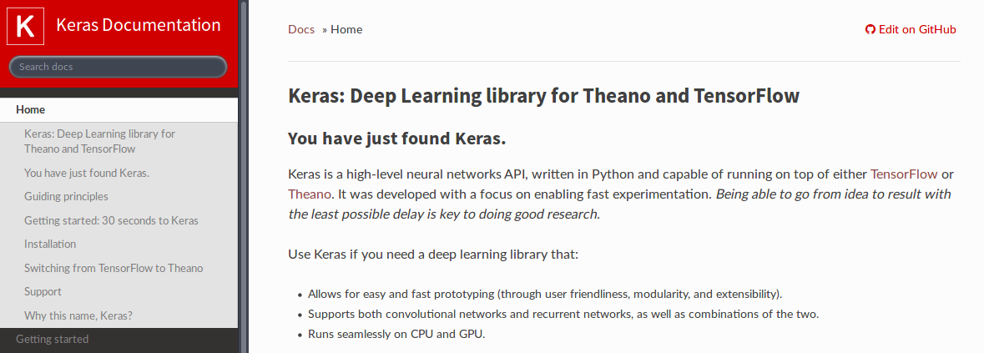
The simple Neuron unit
Linear classifier - steps:
Define the model:
Define the objective:
Define parameter optimizer:
Example in Keras
Notes:
regresja liniowa ma rozwiazanie analityczne, ale my sie ograniczymy do GD, gratient mozna policzyc bo funkcja jest różniczkowalna, ale
nie trzeba bo zrobi to za nast np. tensorflow czy theano,
mini-batch pozwala na effective computation, which can be parralized

Slide 19
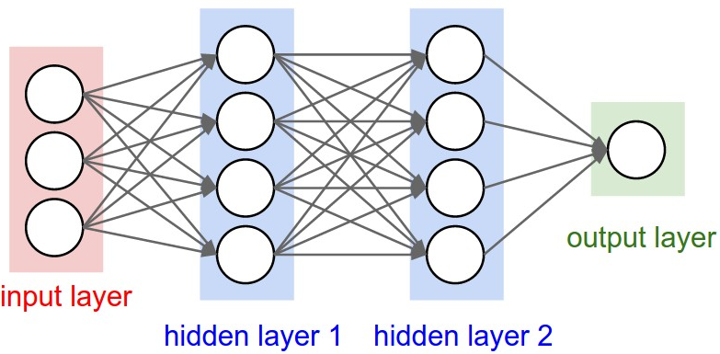
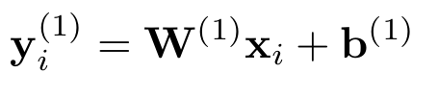
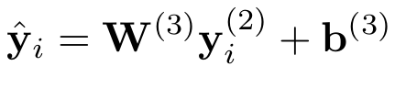
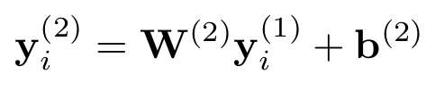
The simple Neuron unit
Linear classifier gives 85% accuracy
Can we stack multiple linear classifiers to build something more powerful?
source Stanford CS231n
Notes:
linear clasiffier gives quite nice result

Slide 20
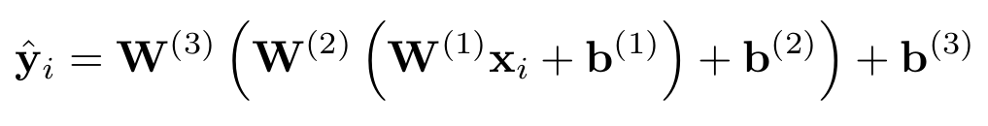
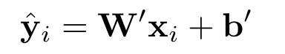
The simple Neuron unit
Linear classifier gives 85% accuracy
Can we stack multiple linear classifiers to build something more powerful?
source Stanford CS231n
Lets
The model with multiple layers cannot be better than single layer case!
Notes:
No we cannot because it is still same linear classifier

Slide 21
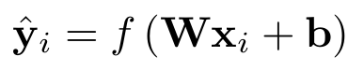
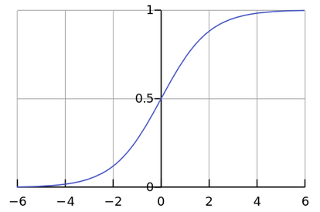
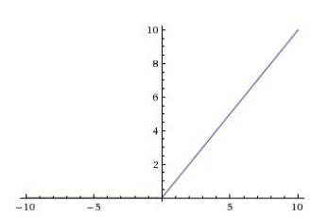
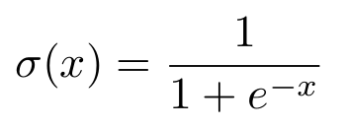
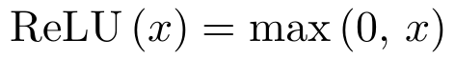
The simple Neuron unit
The definition of neuron
To obtain neuron (fully connected layer) we replace
with
where f(...) is so-called activation function
f is a non linear function hence we cannot factorize multiple layers as before
Some examples:
ReLU (Rectified Linear Unit )
sigmoid
Notes:
Selection of type of activation unit will affect the prediction power of the model, there is no clear clue wchich f should
we use to obtain best results, however Relu is working very nice in practice (gradients ) or other types like LeakyRelu parametric one, are
definitely worth to try

Slide 22
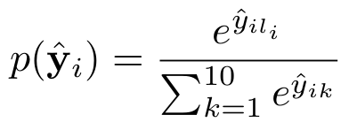
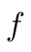
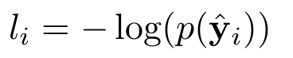
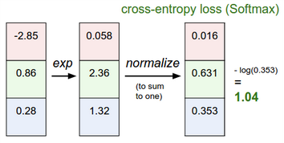
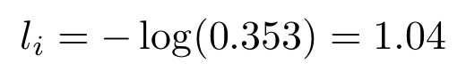
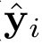
The simple Neuron classifier revisited
We are going to solve the same problem as before lets add nonlinearity
The standard approach for last layer in classification problem is a softmax activation function for 10 classes:
Note: In keras softmax activation returns vector of probabilities
Then the standard approach i to use cross-entropy loss function:
correct class for this example (l_{i})
softmax
source: Stanford CS231 course
Notes:
let assume that our network has 3 outputs (we predict 3 classes), the cross entropy loss works as follow, in this case
we predicted wrong class, hence the large loss, softmax classifier wants to have highes probability for correct class

Slide 23
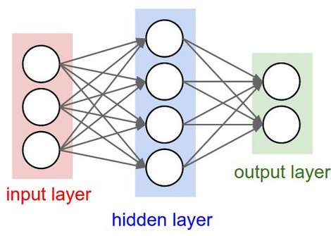
The simple Neuron classifier revisited
Examples in Keras:
single layer with softmax: 0.9 accuracy!
double layer with softmax
ReLU
Softmax
with double layer NN we get 0.98 accuracy!
source: Stanford CS231 course
Notes:
adding non linearity improves results

Slide 24
NN extreme crash course

Slide 25
Neural Networks
Loss function
Activation function
Optimizer
Initialization
Regularization
Backpropagation
Notes:
adding non linearity improves results

Slide 26
Neural Networks
Loss function
Activation function
Optimizer
Initialization
Regularization
Backpropagation
Notes:
adding non linearity improves results

Slide 27
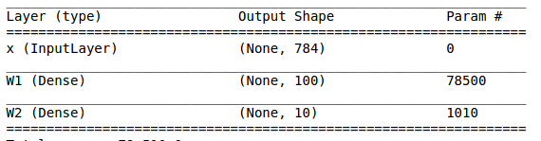
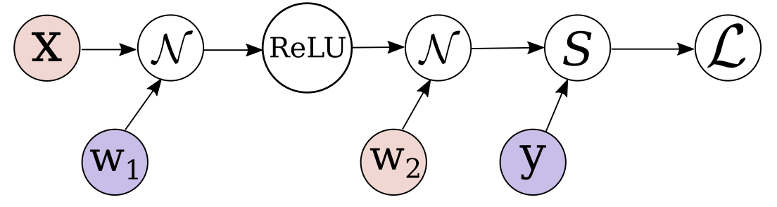
Backpropagation
Backpropagation is a pillar of deep learning
we need to compute gradient of loss with respect to model parameters
Lets come back to our two layer neural network
Notes:
think about graphs where each node is representing some operation and arrows data flow

Slide 28
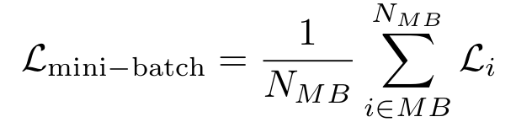
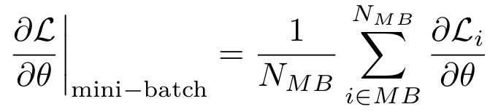
Backpropagation
Backpropagation of mini-batch
hence the gradient
1st example in MB
Avg - is a linear operation hence we can compute gradients for each example in mini-batch separately and then compute mean gradient on mini-batch
2nd example in MB
Avg
Notes:
the minibatch gradient is a sum of gradients genrated by single examples, we can separate then the single example graph
and then remember that resulting gradient is average gradient of examples in mini-batch

Slide 29
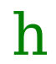
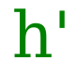
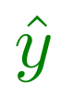
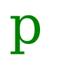



Backpropagation
Forward pass
In forward pass we have to define output value for each type node for given input vector
Notes:
softmax for scalars is the worst idea ever, but we want to understand the idea, and the picture.
Forward pass is realatively easy

Slide 30









Backpropagation
In backward pass we use chain rule to find gradients
Chain rule for w₂
Each of the components can be computed easily e.g.:
Notes:
matrix calculus, one may check that the output is transpose

Slide 31

Backpropagation
In backward pass we use chain rule to find gradients
Chain rule for w₂
Chain rule for w₁
Notes:
softmax for scalars is the worst idea ever, but we want to understand the idea, and the picture.
Forward pass is realatively easy

Slide 32
Backpropagation
What we can learn from that:
if one of the factors is close to zero, gradient vanishes, hence no update
oppositely, many multiplication of large numbers may lead to exploding gradients problem
Notes:
what kind of intuition we get with: solution for vanishing gradients

Slide 33


Backpropagation
What we can learn from that:
We problem of vanishing gradients can be solve with skip connections: ResNet architecture
ImageNet 2015 winning solution
in such case the gradient can propagate by two branches
Notes:
what kind of intuition we get with: solution for vanishing gradients: ResNEt

Slide 34
Neural Networks
Loss function
Activation function
Optimizer
Initialization
Regularization
Backpropagation
Notes:
adding non linearity improves results

Slide 35

Optimizer
We know how the gradients are computed - backpropagation i.e. chain rule
gradients are used to update model parameters:
Batch gradient descent - the simplest and the slowest one, compute gradients for all data
source: S. Ruder post
Notes:
what kind of intuition we get with: solution for vanishing gradients: ResNEt

Slide 36
Optimizer
We know how the gradients are computed - backpropagation i.e. chain rule
gradients are used to update model parameters:
Batch gradient descent - the simplest and the slowest one, compute gradients for all data
Stochastic gradient descent (SGD) - (mini-batch version) - compute gradients for set of examples, typically ~10 to ~100 examples in batch
source: S. Ruder post

Slide 37


Optimizer
Batch gradient descent - the simplest and the slowest one, compute gradients for all data
Stochastic gradient descent (SGD) - (mini-batch version) - compute gradients for set of examples, typically ~10 to ~100 examples in batch
Momentum - improves SGD by adding velocity term which accumulates gradient vector during training
gamma - momentum term, usually 0.9, when 0 we recover SGD
SGD
stops after each step
It simulates Newton dynamics problem with gradient being the force
Note: Momentum equal 1 means no friction, the movement will never stop
source: S. Ruder post
Notes:
In physics we have Newton dynamics where the force is for example gravity, here we have analogical situation but
for is given as a gradient of defined loss function.

Slide 38

Optimizer
Batch gradient descent - the simplest and the slowest one, compute gradients for all data
Stochastic gradient descent (SGD) - (mini-batch version) - compute gradients for set of examples, typically ~10 to ~100 examples in batch
Momentum - improves SGD by adding velocity term which accumulates gradient vector during training
Nesterov accelerated gradient (NAG) - extension to the momentum method, compute gradient by approximating position in the next step
source: S. Ruder post
Notes:
this give some better approximation for the gradients

Slide 39


Optimizer
Batch gradient descent - the simplest and the slowest one, compute gradients for all data
Stochastic gradient descent (SGD) - (mini-batch version) - compute gradients for set of examples, typically ~10 to ~100 examples in batch
Momentum - improves SGD by adding velocity term which accumulates gradient vector during training
Nesterov accelerated gradient (NAG) - extension to the momentum method, compute gradient by approximating position in the next step
Adagrad (Duchi, J 2011)- performs adaptive tuning of learning rate based on model parameters
Gt is a sum of square gradients accumulated over all time steps
source: S. Ruder post
Notes:
main drawback is that the effective learning rate becomes too small very quicly in deep learning networks and
A downside of Adagrad is that in case of Deep Learning, the monotonic learning rate usually proves too aggressive and stops learning too early.

Slide 40
Optimizer
Batch gradient descent - the simplest and the slowest one, compute gradients for all data
Stochastic gradient descent (SGD) - (mini-batch version) - compute gradients for set of examples, typically ~10 to ~100 examples in batch
Momentum - improves SGD by adding velocity term which accumulates gradient vector during training
Nesterov accelerated gradient (NAG) - extension to the momentum method, compute gradient by approximating position in the next step
Adagrad (Duchi, J 2011)- performs adaptive tuning of learning rate based on model parameters
Adadelta (Zeiler, M. D. (2012)), RMSprop (G. Hinton) - extensions to Adagrad, reduces the problem with monotonically decreasing learning rate by
RMSprop implementation: decay_rate is usually 0.9
source: S. Ruder post
Notes:
Adadam and RMSprop they differ a little bit but they share the same idea of introducing a way
for removing the monotically deacreasing gradients in Adagrad

Slide 41
Optimizer
Batch gradient descent - the simplest and the slowest one, compute gradients for all data
Stochastic gradient descent (SGD) - (mini-batch version) - compute gradients for set of examples, typically ~10 to ~100 examples in batch
Momentum - improves SGD by adding velocity term which accumulates gradient vector during training
Nesterov accelerated gradient (NAG) - extension to the momentum method, compute gradient by approximating position in the next step
Adagrad (Duchi, J 2011)- performs adaptive tuning of learning rate based on model parameters
Adadelta (Zeiler, M. D. (2012)), RMSprop (G. Hinton) - extensions to Adagrad, reduces the problem with monotonically decreasing learning rate by
Adam (Adaptive Moment Estimation) (Kingma, D. P., & Ba, J. L. (2015)) - a marriage of momentum and RMSprop methods
source: S. Ruder post

Slide 42

Optimizer
Comparison of different optimizers
Now it is recommended to use Adam, Adadelta, RMSprop
Images credit: Alec Radford.
Notes:
In Image 5, we see their behaviour on the contours of a loss surface over time. Note that Adagrad, Adadelta, and RMSprop almost immediately head off in the right direction and converge similarly fast, while Momentum and NAG are led off-track, evoking the image of a ball rolling down the hill. NAG, however, is quickly able to correct its course due to its increased responsiveness by looking ahead and heads to the minimum.
Image 6 shows the behaviour of the algorithms at a saddle point, i.e. a point where one dimension has a positive slope, while the other dimension has a negative slope, which pose a difficulty for SGD as we mentioned before. Notice here that SGD, Momentum, and NAG find it difficulty to break symmetry, although the two latter eventually manage to escape the saddle point, while Adagrad, RMSprop, and Adadelta quickly head down the negative slope

Slide 43




Optimizer
The choice of the optimizer may significantly affect model predictions
Style transfer: which optimizer choose to get the best results?
source: Slav Ivanov blog post
Notes:
Second-order method use the second derivative (Hessian) to minimize or maximize the function. Since the second derivative is costly to compute, the second-order method in question
L-BFGS - is a second order method, this one is not ususally used in practice because simple SGD based methods are scalling better and are much easier to implement.

Slide 44
Neural Networks
Loss function
Activation function
Optimizer
Initialization
Regularization
Backpropagation
Notes:
adding non linearity improves results

Slide 45

Initialization
We’ve seen the performance of each methods on the convergence:
One of the biggest problems in DL was improper initialization of system parameters
Mostly solved thanks to normalization techniques (discussed later in the talk)
We initialize weights with some small random numbers
This helps to break symmetries in our model
Probably the most popular is Glorot, Bengio (2010) initialization:
Images credit: Alec Radford.
m/n - number of input.output units
We usually initialize bias vector with zero
Notes:
Its clear that if we start close solution we will converge much faster, and due to iterative nature of DL optimizer
we have to do it. The choice will significantly affect how our model will converge. The problem is not yet well
understood, but usually we use simaple initialization and heurisitcs. Glorot: This is default initialization for Dense layers in keras

Slide 46
Initialization
We’ve seen the performance of each methods on the convergence:
One of the biggest problems in DL was improper initialization of system parameters
Mostly solved thanks to normalization techniques (discussed later in the talk)
We initialize weights with some small random numbers
This helps to break symmetries in our model
Less popular but worth to try: orthogonal initialization (Saxe et al. ( 2013 )): orthogonal matrices preserve the norm, hence we can mostly avoid the vanishing and exploding gradients.
Images credit: Alec Radford.
Notes:
Its clear that if we start close solution we will converge much faster, and due to iterative nature of DL optimizer
we have to do it. The choice will significantly affect how our model will converge. The problem is not yet well
understood, but usually we use simaple initialization and heurisitcs.

Slide 47
Initialization
We’ve seen the performance of each methods on the convergence:
One of the biggest problems in DL was improper initialization of system parameters
Mostly solved thanks to normalization techniques (discussed later in the talk)
We initialize weights with some small random numbers
This helps to break symmetries in our model
Sparse initialization (Martens ( 2010 )) - each unit is initialized to have k non-zero weights
Images credit: Alec Radford.
Notes:
Its clear that if we start close solution we will converge much faster, and due to iterative nature of DL optimizer
we have to do it. The choice will significantly affect how our model will converge. The problem is not yet well
understood, but usually we use simaple initialization and heurisitcs.

Slide 48
Neural Networks
Loss function
Activation function
Optimizer
Initialization
Regularization
Backpropagation
Notes:
adding non linearity improves results

Slide 49


Loss function
By choosing loss function we shape the gradient flow in the network
The type of used loss function will depend on the type of problem we want to solve
Classification problem:
hinge loss
softmax loss
also squared hinge loss

Slide 50


Loss function
Regression problem: prediction of real valued quantities (e.g. average price)
squared L2 norm
L1 norm
and many others: cosine proximity, KL divergence, ...

Slide 51


Loss function
Choosing loss function may have very serious consequences on model accuracy
Task: Given the input image in grayscale predict its pixel color:
Zhang, Isola, Efros. Colorful Image Colorization. ECCV, 2016.
Notes:
recent paper about how efecively colorize images:

Slide 52



Loss function
Choosing loss function may have very serious consequences on model accuracy
Instead of they use multinomial classification problem on ab color space
A natural choice of loss function could be L2 norm
Weighted cross-entropy loss
Notes:
recent paper about how efecively colorize images:

Slide 53


Loss function
Choosing loss function may have very serious consequences on model accuracy
Colorization of old and out of the dataset images:
Notes:
recent paper about how efecively colorize images:

Slide 54
Neural Networks
Loss function
Activation function
Optimizer
Initialization
Regularization
Backpropagation
Notes:
adding non linearity improves results

Slide 55




Activation functions - zoo
Activation function is a necessary building block which introduces nonlinearity to increase capacity of neural network
most common and easy to optimize
We have already seen some of them:
hard to train because of saturated gradient
2012 - It was shown that network with ReLU learnt several times faster with ReLU units
Hyperbolic tangent:
tanh
Krizhevsky, A. 2012 ImageNet
winning solution
ReLU
Notes:
recent paper about how efecively colorize images:

Slide 56


Activation functions - zoo
Activation function is a necessary building block which introduces nonlinearity to increase capacity of neural network
ReLU
Leaky ReLU - allows for small negative values
Parametric ReLU - alpha is learned
maxout - as a generalization of ReLUs family
dying gradients problem
It is worth to try all activations from ReLU family, but probably one will end up with the simplest one.
Notes:
the choice of the activation function will depent on specific problem we are trying to

Slide 57
Neural Networks
Loss function
Activation function
Optimizer
Initialization
Regularization
Backpropagation
Notes:
adding non linearity improves results

Slide 58
Short break

Slide 59
Neural Networks
Loss function
Activation function
Optimizer
Initialization
Regularization
Backpropagation
Notes:
adding non linearity improves results

Slide 60
Regularization
Regularization is a way to preventing our model from overfitting
Overfitting is when our model learn to remember data instead to understanding them
Keras overfitting example
Notes:
good practice to test model on small amount of data before training, if its overfitting it means that is has enoungh capacity to learn
something from our data

Slide 61



Regularization - zoo
Parameter norm penalties
Add second term which penalizes special values of model parameters
we want to put penalties on our model parameters in order to prevent overfitting
L2 regularization
with gradient
L2 works as soft constraint on the values of the W matrix, large values are forbidden since they lead to large loss
usually small number, model hyperparameter
Notes:
L@ norm is probably the most popular one amongs wieght regularizers. One has to run model
with multiple values of lambda in order to find the best value.

Slide 62

Regularization - zoo
Parameter norm penalties
L2 regularization
with gradient
Regularization has smoothing effect on model predictions:
consider following task: separate green dots from red
source: kdnuggets.com
Notes:
How does the regularization works?

Slide 63




Regularization - zoo
Parameter norm penalties
L2 regularization
with gradient
L1 regularization
with gradient
the L1 regularization leads to a sparse matrices
In practice L2 can be expected to overperform L1 regularization
first “W image” with L2
first “W image” with L1
Notes:
How does the regularization works?

Slide 64

Regularization - zoo
Constraints regularizers
max norm constraint -
non negativity constraint - each element of the W matrix must be positive
unit norm - enforces the matrix to have unit norm along the last axis
in keras we can do it easily:
Notes:
and then enforcing the constraint by clamping the weight vector w⃗ of every neuron to satisfy

Slide 65


Regularization - zoo
Data augmentation = more data better generalization => generate more data based on existing ones
for images one may apply translations, rotations, stretching, shearing, distortion
Keras has cool Image generator class which allows for online augmentation during training
whenever you can, use it !
Notes:
powerfull technique especially usefull in image processing, beause it is quite easy to generate new images from existing ones

Slide 66




Regularization - zoo
Dropout - 2014
The idea behind the dropout
Standard Neuron:
Standard Neuron with dropout:
binary mask created with probability p
source: Srivastava, 2014
Example in keras
Notes:
Dropout is a simple and effeicient way to intro bagging into the model architecture. Dropout trains ensemble of models
which shares hidden units. This method is so popular such it is even more frequelnty used than any other regularization method.
It can be incorporated into almost architectures.

Slide 67



Regularization - zoo
Normalization layers family - prevent overfitting and speed up training
Batch normalization (2015) - introduces normalization operation in a differentiable manner
Normalize the inputs of hidden layer using mini-batch statistic
In mini-batch we have many examples
output on hidden unit
for a single example
Notes:
recal the simple nerual unit, mostlysolvers initialization problesm and dacaying and exploding gradients

Slide 68

Regularization - zoo
Normalization layers family - prevent overfitting and speed up training
Batch normalization (2015) - introduces normalization operation in a differentiable manner
Normalize the inputs of hidden layer using mini-batch statistic
The NB algorithm (per particular activation)
In mini-batch we have many examples
source: BN - paper
Notes:
recal the simple nerual unit

Slide 69

Regularization - zoo
Normalization layers family - prevent overfitting and speed up training
Batch normalization (2015) - introduces normalization operation in a differentiable manner
With batch normalization one may:
increase learning rate
in some cases remove Dropout
reduce L2 regularization
source: BN - paper
Notes:
Batch Normalization adds only two extra parameters per activation, and in doing so preserves the representation ability of the network, x50 means that they
increase learning rate 50 times. bad stats: consider situation that in one batch we have examples of the same class

Slide 70

Regularization - zoo
Normalization layers family - prevent overfitting and speed up training
Batch normalization (2015) - introduces normalization operation in a differentiable manner
Layer normalization (2016) - normalize hidden activation per example in mini-batch (paper)
Batch normalization has problems with RNNs, here the normalization depends only on current step hence it can be applied to normalize RNNs networks
Notes:
ne where BNis only applied to the LSTM while the other applies BN everywhere throughout the model. LN is a similar idea as BN however we normalize intputs taking account only current example not
mn stats

Slide 71

Regularization - zoo
Normalization layers family - prevent overfitting and speed up training
Batch normalization (2015) - introduces normalization operation in a differentiable manner
Layer normalization (2016) - normalize hidden activation per example in mini-batch (paper)
Weight normalization (2016) - normalize weight matrix instead of activations: replace w with v and g (paper), can be applied to RNNs
Notes:
ne where BNis only applied to the LSTM while the other applies BN everywhere throughout the model.

Slide 72
Regularization - zoo
Normalization layers family - prevent overfitting and speed up training
Batch normalization (2015) - introduces normalization operation in a differentiable manner
Layer normalization (2016) - normalize hidden activation per example in mini-batch (paper)
Weight normalization (2016) - normalize weight matrix instead of activations: replace w with v and g (paper), can be applied to RNNs
Batch renormalization (Feb 2017!) - quite promising, extension to the original BN paper. Its done by introducing additional learnable parameters which fix the difference between train and test inference, learning is quite tricky and demands hand tuning.
Notes:
BNr requires hand tunning of some parameters, so probably it will make this methos not usefull for diverse application, however
maybe someone will

Slide 73

Regularization - zoo
Normalization layers family - prevent overfitting and speed up training
Batch normalization (2015) - introduces normalization operation in a differentiable manner
Layer normalization (2016) - normalize hidden activation per example in mini-batch (paper)
Weight normalization (2016) - normalize weight matrix instead of activations: replace w with v and g (paper), can be applied to RNNs
Batch renormalization (Feb 2017!) - quite promising, extension to the original BN paper. Its done by introducing additional learnable parameters which fix the difference between train and test inference, learning is quite tricky and demands hand tuning (paper)
Orthogonalization regularization (Feb 2017!) - make you matrix to be an orthogonal one! Cool - it preserves the norm and make gradients more stable (Neural Photo Editing with Introspective Adversarial Networks)
Notes:
Sigma meant that the dot product was taken along filter bank and summed up, sum across filter banks, so W is a filter bank

Slide 74
Regularization - zoo
Normalization layers family - prevent overfitting and speed up training
Batch normalization (2015) - introduces normalization operation in a differentiable manner
Layer normalization (2016) - normalize hidden activation per example in mini-batch (paper)
Weight normalization (2016) - normalize weight matrix instead of activations: replace w with v and g (paper), can be applied to RNNs
Batch renormalization (Feb 2017!) - quite promising, extension to the original BN paper. Its done by introducing additional learnable parameters which fix the difference between train and test inference, learning is quite tricky and demands hand tuning (paper)
Orthogonalization regularization (Feb 2017!) - make you matrix to be an orthogonal one! Cool - it preserves the norm and make gradients more stable (Neural Photo Editing with Introspective Adversarial Networks)
Cosine normalization (Feb 2017!) - replace dot product with cosine similarity (paper)
Notes:
Sigma meant that the dot product was taken along filter bank and summed up, sum across filter banks, so W is a filter bank

Slide 75



Regularization - zoo
Normalization layers family - prevent overfitting and speed up training
Cosine normalization (Feb 2017!) - replace dot product with cosine similarity
instead this:
use this:
easy to implement
faster learning
better accuracy
can be applied to RNNs

Slide 76
Neural Networks
Loss function
Activation function
Optimizer
Initialization
Regularization
Backpropagation
Notes:
adding non linearity improves results

Slide 77
Thank you for your attention
Krzysztof Kolasiński krzysztof.kolasinski@fornax.ai

Slide 78
Appendix

Slide 80


Epilogue: The neural nets “paradox”
Given the input image:
We permute every pixel:
Then apply the same permutation for every image in dataset
and train Neural Network
What NN network will learn? Will it perform better or worse ?
It will learn exactly the same (in terms of accuracy)!

Slide 81



Epilogue: The neural nets “paradox”
Given the input image:
We permute every pixel:
Explanation:
we notice that permutation is a rotation operation
we work with single layer NN (before permutation)
x_{i}
x_{i}’ = Rx_{i}
and after permutation
We assume (with primes) that our model will learn different parameters
Notes:
rotations are linear operation, hence can be represent by matrix multiplications, we augmented data so de parameters should also be different

Slide 82






Epilogue: The neural nets “paradox”
x_{i}
Given the input image:
we don’t permute labels hence our predictions must be the same
we ask then if this is possible
softmax
we get condition to satisfy
x_{i}’ = Rx_{i}
+ const
+ const
hence both sides are equal when
- const
Notes:
f is an arbitray actication function hence, the arguments must be the same, assuming that the model will reach the same global minimum in both cases
the W’ and W have to be related with this simple relation

Slide 83




Epilogue: The neural nets “paradox”
x_{i}
Let’s check it in Keras:
Given the input image:
Learned weights do not correspond to anything intuitive (for humans)
x_{i}’ = Rx_{i}
After rotation!

Slide 84
Epilogue: The neural nets “paradox”
x_{i}
Given the input image:
Ok, but what we can learn from that?
NNs do not capture spatial correlations in data
NNs are not translational and rotational invariant, small shift in the image is enough to get wrong predictions
The same with scaling
x_{i}’ = Rx_{i}
Ok, how we can solve those problems?
For images use CNNs! Next talk :)
Notes:
how often we deal with data that at first look they do not

Slide 85
References
http://uvadlc.github.io/lectures/lecture1.pdf
https://chaosmail.github.io/deeplearning/2016/10/22/intro-to-deep-learning-for-computer-vision/
http://karpathy.github.io/2016/05/31/rl/
https://culurciello.github.io/tech/2016/06/04/nets.html
http://www.asimovinstitute.org/neural-network-zoo/
https://blog.acolyer.org/2017/03/24/a-miscellany-of-fun-deep-learning-papers/ importance of loss function
http://cs231n.github.io/linear-classify/
http://sebastianruder.com/optimizing-gradient-descent/

Slide 86

Why do we need DL?
DL is fun!
Input
Reference
Output
Deep Photo Style Transfer paper from 22 March 2017 !
Project page: https://github.com/luanfujun/deep-photo-styletransfer

Slide 87

Learning process
Learning is a mathematical process of tuning our DL architecture to achieve some desired target
We can distinguish few types of learning strategies:
supervised learning (today’s workshop!) - neural networks, CNNs
unsupervised learning - Autoencoders, RBMs
semi-supervised learning - mix of above
reinforcement learning - agents must act to maximize the rewards
Notes:
Reinforcement learning is the problem of getting an agent to act in the world so as to maximize its rewards. For example, consider teaching a dog a new trick: you cannot tell it what to do, but you can reward/punish it if it does the right/wrong thing. It has to figure out what it did that made it get the reward/punishment, which is known as the credit assignment problem. We can use a similar method to train computers to do many tasks, such as playing backgammon or chess, scheduling jobs, and controlling robot limbs.

Slide 88


Regularization - zoo
Dropout - 2014
Standard Neuron:
Standard Neuron with dropout:
binary mask created with probability p
Example in keras
Notes:
Dropout is a simple and effeicient way to intro bagging into the model architecture. Dropout trains ensemble of models
which shares hidden units. This method is so popular such it is even more frequelnty used than any other regularization method.
It can be incorporated into almost architectures. float between 0 and 1. Fraction of the input units to drop.

Slide 89


Why do we need DL?
2. DL is important
“DQN achieved human-level performance in almost half of the 50 games to which it was applied”
Natural Language Processing e.g. speech recognition task

Slide 90


Regularization - zoo
Parameter norm penalties
L2 regularization
with gradient
Regularization has smoothing effect on model parameters:
before regularization
after adding L2 regularization
source: Sam's Research Blog
Notes:
How does the regularization works?

Slide 91


Regularization - zoo
Noise regularizers
add noise with infinitesimal variance to input of the model
add noise to hidden activations
Early stopping: stop training before overfitting of model with large capacity
Algorithm:
Monitor your training and validation loss
Stop training when the validation loss starts to increase
In keras we can use callbacks
Notes:
when we add noise to the model we force model to be resist to some random perturbation, hence it should in general lead to better generalization,
we need two datasets so it can be a problem when we do not have eanough samples

Slide 92
Regularization - zoo
Noise regularizers
add noise with infinitesimal variance to input of the model
add noise to hidden activations
Early stopping: stop training before overfitting of model with large capacity
Ensembling and bagging methods, etc …
Notes:
baging construct many datasets from orignal one by sampling with replacement. If you want to win kaggle competition you definitely have to think
about some of those methods

Slide 93

Backpropagation
Everything is a graph...
Notes:
example of tensorflow graph

